Slide 1
Design And Analysis of Algorithms OPTIMIZING MAKESPAN
By
K . Sai Anirudh (2010030083)
Cheethirala Varun (2010030031)
M .D . Fauzaan (2010030452)
B. Vegesh Sai (2010030024)
Under the guidance of
P. SREELAKSHMI

Slide 2
Problem statement
There are n machines and m jobs. Each job contains exactly n operations. The i-th operation of the job must be executed on the i-th machine. No machine can perform more than one operation simultaneously. For each operation of each job, execution time is specified. Operations within one job must be performed in the specified order. The first operation gets executed on the first machine, then (as the first operation is finished) the second operation on the second machine, and so until the n-th operation. Jobs can be executed in any order, however. Problem definition implies that this job order is exactly the same for each machine. The problem is to determine the optimal such arrangement, i.e. the one with the shortest possible total job execution makespan.

Slide 3
Existing solutions/ Naïve solutions
Branch and Bound.
Dynamic programming.
Heuristic algorithm.
Meta-heuristics.

Slide 4
Proposed Algorithm Design Technique
We are going with Branch and Bound where we use Johnson's Rule and Heuristic algorithms where we use NEH algorithm
Johnson's rule is used up to three machine problem and heuristic algorithm is used for n machines .
Whereas in Heuristic Algorithm it used for m x n where m=no. of jobs and n = no. of machines to minimize the makespan.
Generally, it is considered to be NP-Hard if we consider more than 3 machines and in the case of 2 to 3 machines the best-case scenario is O(nlogn)

Slide 5
Data Structures needed
Queue-Array
A queue is a linear data structure in which the order of operation is FIFO (first in first out).
The array is a data structure that contains elements of the same data type, stored in continuous memory location.
In queue the insertion and deletion operations as done at opposite ends of the queue.

Slide 6
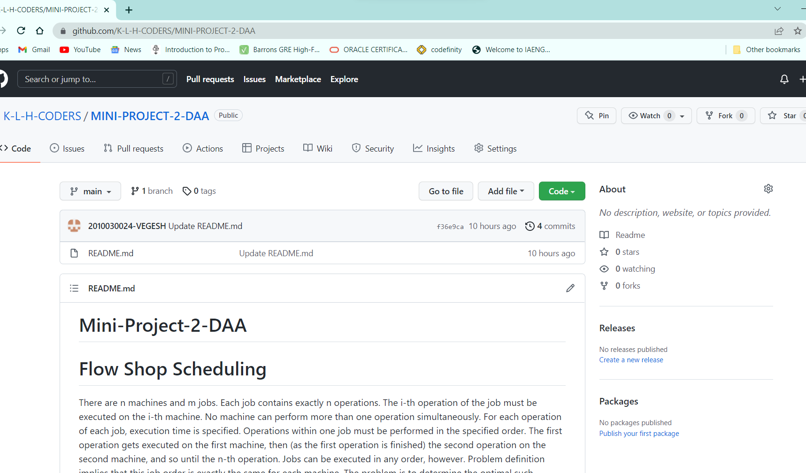
GitHub setup

Slide 7
Division of work among the group members
BOPPANA VEGESH SAI – IMPLEMENTATION OF ALGORITHM
FAUZAAN – ALGORITHM DESIGN
CH.VARUN – GITHUB AND REQUIREMENTS GATHERING
ANIRUDH – REQUIREMENTS GATHERING AND DOCUMENT PREPARATIONS

